Slide 1

Build an Android App
Jon Douglas

Slide 2
Class Structure
90 minute classes (10am – 11:30am)
4 Total Classes (Lots to cover!)
Feel free to ask questions at any time during the lectures
Some lectures will be more “Follow along” where-as others will be presentations

Slide 3
Assumptions about you
Basic Computer Skills
Know how to use a smartphone
Own a computer Nice to have:
Programming Experience (Tinkering / General Interest)

Slide 4
Common Obstacles
Lack of confidence that you can one day become a developer
Code looks intimidating
Tools can be complex
Lots of jargon thrown around
Concepts are too abstract

Slide 5
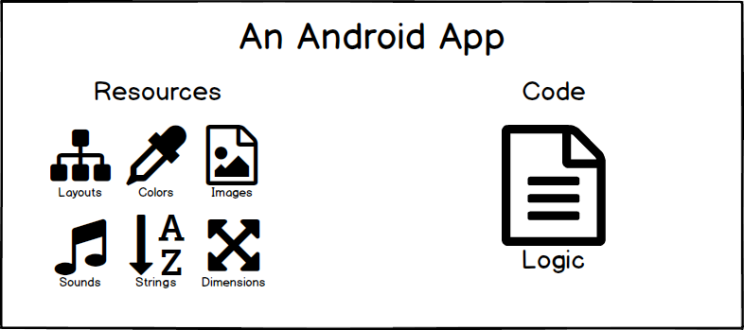
Visuals
For all the visual learners out there, I will be including plenty of drawings, analogies, and stories to explain technical concepts that can be confusing.

Slide 6
Vocabulary
As mentioned earlier, there will be lots of jargon that you may have never heard of. Thankfully Google has put together a nice resource to learn from. You can see the following link: https://developers.google.com/android/for-all/vocab-words/?hl=en for more information.

Slide 7

What Android Is
Operating System (Based on Linux)
Application Framework (Android SDK)
Compiler and Packaging Tools

Slide 8
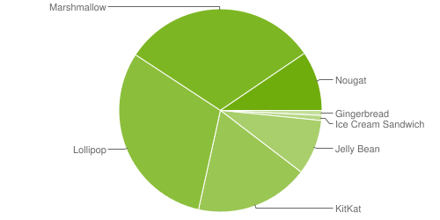
Android Dashboard
https://developer.android.com/about/dashboards/index.html

Slide 9
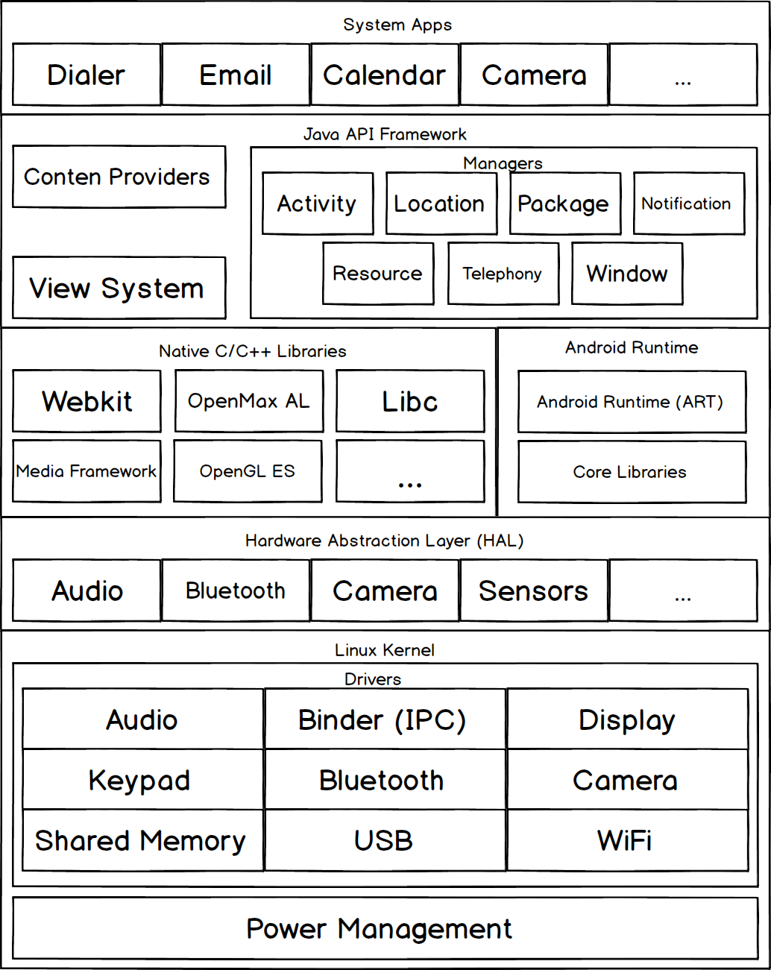
Android Architecture
Notes:
CMD+OPTION+8 TO ZOOM

Slide 10
Programming Language
Java (https://docs.oracle.com/javase/tutorial/)
public class Program {
public static void main(String[] args) {
System.out.println("Hello World!");
}
}
Notes:
CMD+OPTION+8 TO ZOOM

Slide 11
Programming Language
C# (https://www.microsoft.com/net/tutorials/csharp/getting-started)
public class Program
{
public static void Main()
{
Console.WriteLine("Hello World!");
}
}
Notes:
CMD+OPTION+8 TO ZOOM

Slide 12
Layout Language
XML (https://www.w3schools.com/xml/)
<?xml version="1.0" encoding="utf-8"?>
<LinearLayout xmlns:android="http://schemas.android.com/apk/res/android"
android:layout_width="match_parent"
android:layout_height="match_parent"
android:orientation="vertical" >
<TextView android:id="@+id/text"
android:layout_width="wrap_content"
android:layout_height="wrap_content"
android:text="Hello, I am a TextView" />
<Button android:id="@+id/button"
android:layout_width="wrap_content"
android:layout_height="wrap_content"
android:text="Hello, I am a Button" />
</LinearLayout>
Notes:
CMD+OPTION+8 TO ZOOM

Slide 13


Installing the tooling
Notes:
CMD+OPTION+8 TO ZOOM

Slide 14
Installing the tooling
Android Studio Download
https://developer.android.com/studio/index.html
Visual Studio Download
https://developer.xamarin.com/guides/android/getting_started/installation/
Notes:
CMD+OPTION+8 TO ZOOM

Slide 15
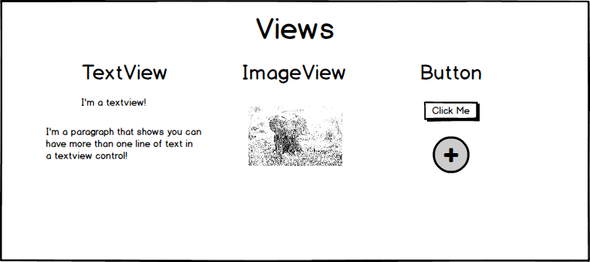
Android Basics: Views
Views are rectangles that are drawn on the screen. They are the building block to build the layout for your application.
Notes:
CMD+OPTION+8 TO ZOOM

Slide 16
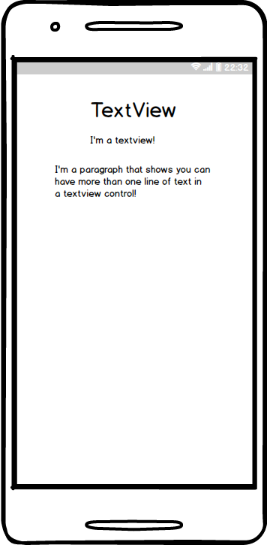
Android Basics: TextView
Notes:
CMD+OPTION+8 TO ZOOM

Slide 17
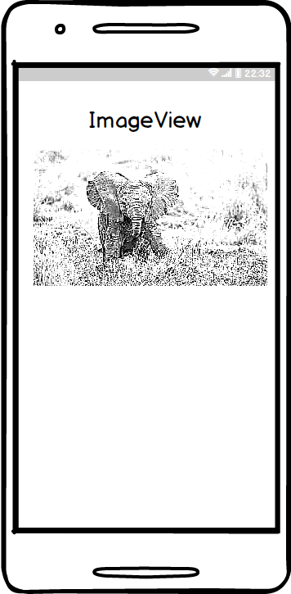
Android Basics: ImageView
Notes:
CMD+OPTION+8 TO ZOOM

Slide 18
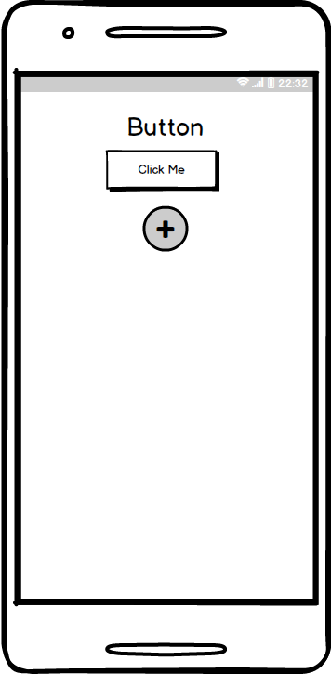
Android Basics: Button
Notes:
CMD+OPTION+8 TO ZOOM

Slide 19
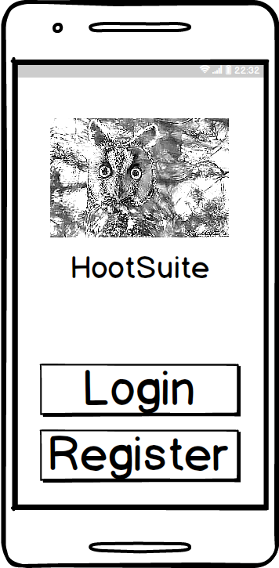
Android Basics: ViewGroups
A group of Views is known as a `ViewGroup`. A group of views are usually inside of a layout. Popular layouts like `LinearLayout` and `RelativeLayout` are considered `ViewGroup`.
Notes:
CMD+OPTION+8 TO ZOOM

Slide 20
Defining Views in XML
Views in XML have two main items:
1. Control Definition
2. Control Attributes
<TextView
android:text="Happy Birthday!"
android:background="@android:color/blue"
android:layout_width="150dp"
android:layout_height="75dp" />
Notes:
CMD+OPTION+8 TO ZOOM

Slide 21
Special height/width values
wrap_content - Wraps until content fills height and width
match_parent - Matches the parent View's height and width
Notes:
CMD+OPTION+8 TO ZOOM

Slide 22
Look at the documentation
Search Google with an Android keyword
Use your browser's "Find Feature"
Implement the code in Android Studio
Deploy to Device!
Notes:
CMD+OPTION+8 TO ZOOM

Slide 23
Quiz #1
If I want to show a picture on my phone, what XML element should I use?
Notes:
CMD+OPTION+8 TO ZOOM

Slide 24
Quiz #1 - Answer
<ImageView />
Notes:
CMD+OPTION+8 TO ZOOM

Slide 25
Quiz #2
The following items are examples of what?
android:layout_width
android:text
android:src
A) Design Items B) Attributes C) Definitions
Notes:
CMD+OPTION+8 TO ZOOM

Slide 26
Quiz #2 - Answer
B) Attributes
Notes:
CMD+OPTION+8 TO ZOOM

Slide 27
Quiz #3
Write the following sentence in Camel Case:
"The cow jumped over the moon”
Note: Upper Camel Case removes all spaces from a string and uppercases each word.
Notes:
CMD+OPTION+8 TO ZOOM

Slide 28
Quiz #3 - Answer
TheCowJumpedOverTheMoon
Notes:
CMD+OPTION+8 TO ZOOM

Slide 29
Quiz #4
`LinearLayout` and `RelativeLayout` are examples of what?
A) Group
B) ViewGroup
C) LayoutGroup
D) ObjectGroup
Notes:
CMD+OPTION+8 TO ZOOM

Slide 30
Quiz #4 - Answer
B) ViewGroup
Notes:
CMD+OPTION+8 TO ZOOM

Slide 31
Quiz #5
You always need to ____ and ____ your XML tags.
Notes:
CMD+OPTION+8 TO ZOOM

Slide 32
Quiz #5 - Answer
You always need to open and close your XML tags.
Notes:
CMD+OPTION+8 TO ZOOM

Slide 33
Quiz #6
What is the width of the `TextView`?
<RelativeLayout
android:layout_width="350dp"
android:layout_height="match_parent">
<TextView
android:layout_width="match_parent"
android:layout_height="wrap_content"
android:text="Hello There"/>
</RelativeLayout>
Notes:
CMD+OPTION+8 TO ZOOM

Slide 34
Quiz #6 - Answer
350dp
Notes:
CMD+OPTION+8 TO ZOOM

Slide 35
Android Studio Tour
Notes:
CMD+OPTION+8 TO ZOOM

Slide 36
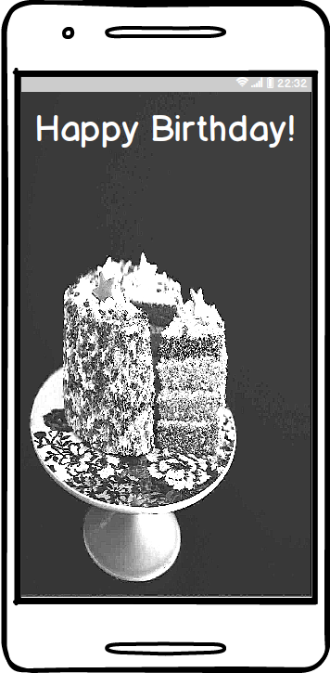
App #1 – Birthday Card
Design and implement a simple app that displays "Happy Birthday" to one of your loved ones.
Notes:
CMD+OPTION+8 TO ZOOM

